Slide 1
Data Visualization 100
Final Project
by
Aleksey Kramer

Slide 2
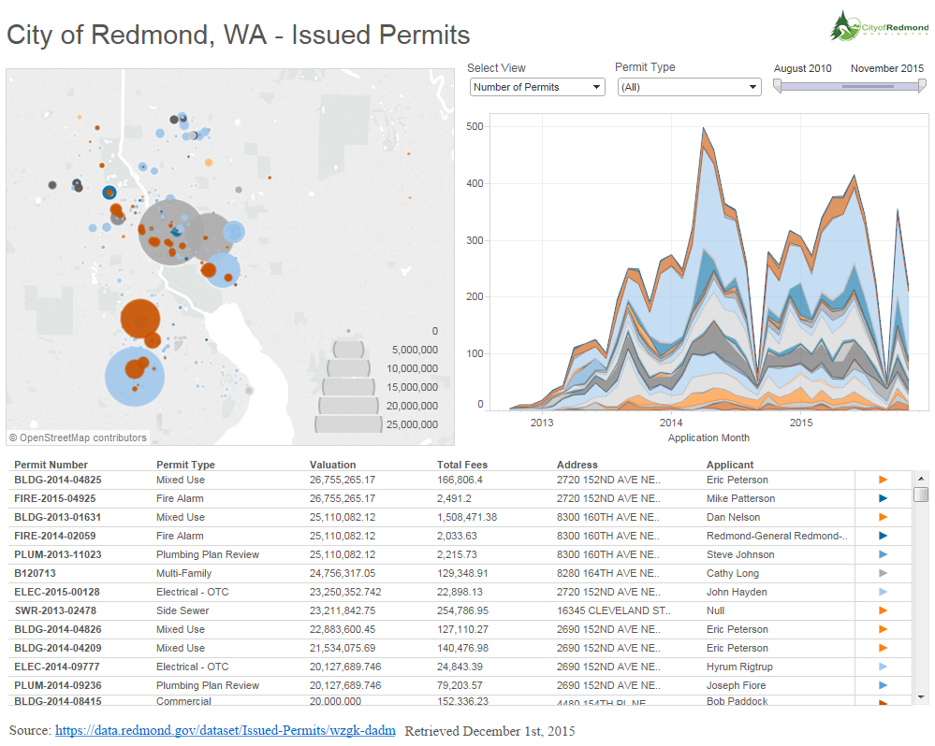
Viz. Screenshot and URL
Final Project URL: https://public.tableau.com/profile/publish/DATAVIZ100-FINALPROJECT/DATAVIZ100-FinalProject#!/publish-confirm

Slide 3
Explanations
The vis is designed to present number of issued permits in Redmond, WA, USA
Permit Type dropdown is the main driver for the viz. The visualization elements are synchronized to reflect changes is selected data. Map does not work well if individual values (per month) are selected in the timeline.
The time frame of the dataset stretches from 2010 through 2015, however, the real data is present from mid 2012 onward
I have included a parameter with three options, a graphic, URL’s, two chart types (one of them is MAP), and a data table.
I am totally lacking any artistic talent, so my visualization may seam plain, but I really tried.
P.S. You make it look really easy, however, in reality, working with Tableau is quite hard.

Slide 4
City of Redmond - Issued Permits Database
URL of the data: https://data.redmond.gov/dataset/Issued-Permits/wzgk-dadm
Method: Exploratory
Data Retrieved 12/01/2015
Data is modified to separate Latitude and Longitude from the Address field in the dataset
Incomplete records (null values for longitude and latitude) are removed
Valuation and Total Fees fields changed to be type of Currency

Slide 5
The story (Planned)
Show the number of permits issued over time
Show the permits on the map
Show revenue received from permits
Show valuation of the projects
Show sorted table of the projects per category

Slide 6
Some of the Data Fields
Permit Number – Unique permit number
Address – Full address
Coordinates – longitude and latitude pair
Longitude – longitude
Latitude – latitude
Permit Type – a type of permit, categorical
Work Class – class of work, categorical
Apply Date – date of the application
Issue Data – date the permit was issued
Permit Detail – URL
Valuation – Cost of the project
Sq FT – square footage affected by the project
Total Fees – fees paid to the City of Redmond

